Slide 1
Leeds Beckett University
Cloud Computing Development
Dr Anatoliy Gorbenko
E-mail: A.Gorbenko@leedsbeckett.ac.uk
Dr Kumar Satish
E-mail: S.Kumar@leedsbeckett.ac.uk

Slide 2
Cloud Computing Development
Introduction to CCD Module
Anatoliy Gorbenko
Kumar Satish

Slide 3
Anatoliy Gorbenko E-mail: A.Gorbenko@leedsbeckett.ac.uk
Kumar Satish E-mail: S.Kumar@leedsbeckett.ac.uk
Module Team

Slide 4
Module Content
Introduction to Cloud Computing
Cloud Computing Paradigms
IaaS
PaaS
SaaS
SOA and Web Services
Virtualization technologies
Big Data technologies
Cloud Computing Development and Deployment
Web Services
Microsoft Azure
Amazon AWS
Google App Engine

Slide 5
Module Aim & Objectives
This module aims to give understanding of the Cloud Computing architecture, technologies and providers. The module will enable to develop, deploy and run cloud services and applications.
Learning outcome 1: to have a critical understanding of the various cloud service providers and the technologies used.
Learning outcome 2: critically evaluate various cloud service providers and their services.
Learning outcome 3: understand cloud architectures, technologies and protocols that are used to communicate with server side software.
Learning outcome 4: to develop cloud services and programming paradigms to provide these to client side systems.

Slide 6
Practical works
Labs focus on SW development and deployment on Clouds
Involve:
AWS EC2 (Infrastructure-as-a-Service),
AWS Elastic Beanstalk (Platform-as-a-Service),
AWS Lambda (Function-as-a-Service),
Microsoft Azure (IaaS/PaaS)
Skills and knowledge desired:
Software development skills are essential (Java, C++/C#)
Networking/Web technologies
Administration/Devops

Slide 7
Registration with Cloud Providers
To complete labs you will need to sign up for free tier AWS and Microsoft Azure accounts.
Use your UNIVERSITY EMAIL ACCOUNT to sign up. The trial accounts offer a number of services free of charge for 1 month/year/forever (reads terms and conditions).
Nevertheless, you might be asked to provide CREDIT CARD DETAILS to verify identity.
You will NOT be charged UNLESS explicitly select and agree to use a paid service OR exceed the free limits (e.g. 750 hours of t2.micro Amazon EC2 instance per months). Thus, keep an eye on the resources used and do not exceed the specified limits, which are much more than it is necessary to complete the labs.
The best way to do this is to delete all created resources (e.g. VMs, disks, environments) after you complete the lab and read carefully all emails from Cloud Providers! The staff is not responsible for any financial expenses caused by the above reasons!

Slide 8
Delivery Plan
Week | Session
Week 1 | Lecture: Introduction to CCD module and assessment brief Lab: Register with Cloud Providers: AWS, AWS Educate, Microsoft Azure
Week 2 | Lecture: Evolution of Distributed Computer Systems Lab: IaaS – Deployment of Windows and Linux VMs with AWS EC2
Week 3 | Lecture: Fundamentals of Cloud Computing Lab: IaaS – Deployment of Windows and Linux VMs with Microsoft Azure
Week 4 | Lecture: Cloud Computing Models Lab: PaaS - Exploration and Deployment of WCF C# web services with AWS Elastic Beanstalk and Microsoft Azure
Week 5 | Lecture: Service Oriented Architecture and Web Services Lab: PaaS - Development of WCF C# web services and deployment with AWS Elastic Beanstalk and Microsoft Azure
Week 6 | Lecture: SOAP and RESTful Web Services Lab: PaaS - Development of SOAP Java web services for deployment on IaaS
Week 7 | Lecture: Virtualization Technologies Lab: PaaS - Exploration and Deployment of RESTful Java web services with AWS Elastic Beanstalk
Week 8 | Lecture: Introduction to BigData Lab: PaaS - Development of RESTful Java web services and deployment with AWS Elastic Beanstalk
Week 9 | Lecture: BigData storage and processing: NoSQL and Hadoop Lab: FaaS - Development of a serverless web service with AWS Lambda
Week 10 | Lecture: No new lecture this week; work on your report Lab: Infrastructure-as-code/Devops – Automated VMs provisioning on Amazon EC2 using Terraform
Week 11 | Lecture: No new lecture this week; work on your report Lab: No new lab this week; work on your report
Week 12 | Report due: 15/12/23 (23:59)
Week 13 | Recap week: Question your tutor and get prepared for the final test
Week 14 | Final test: W/C 09/01/2023

Slide 9
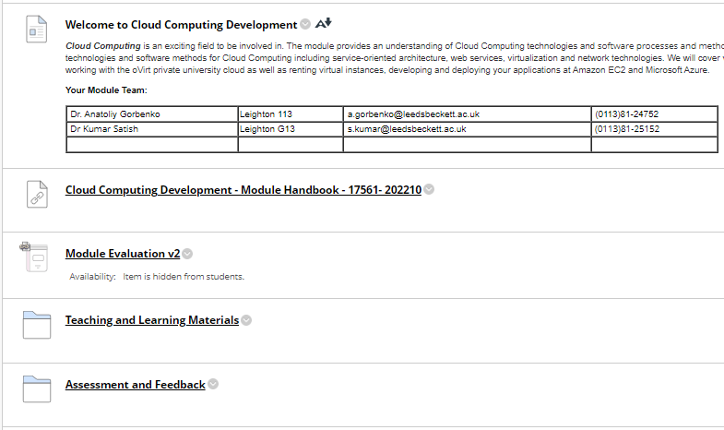
Learning environment - VLE
Module content:

Slide 10
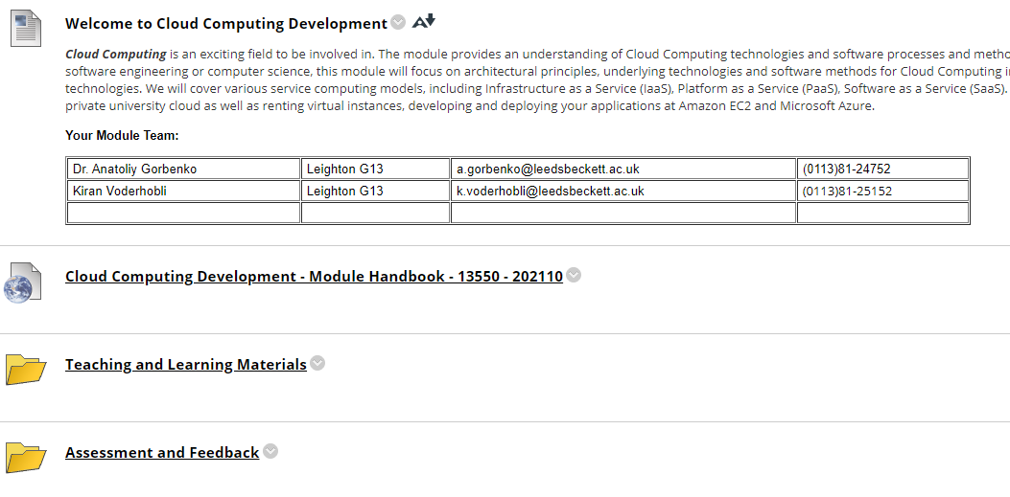
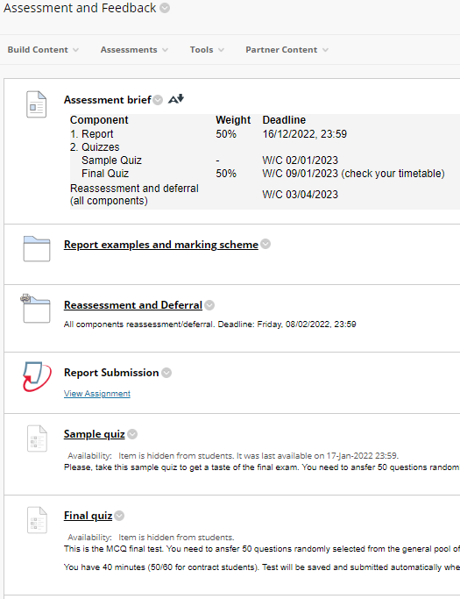
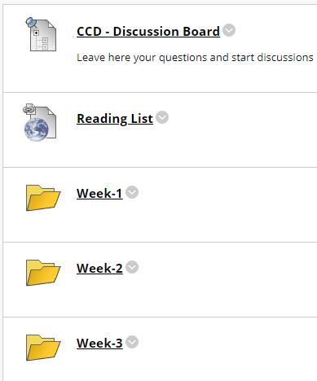
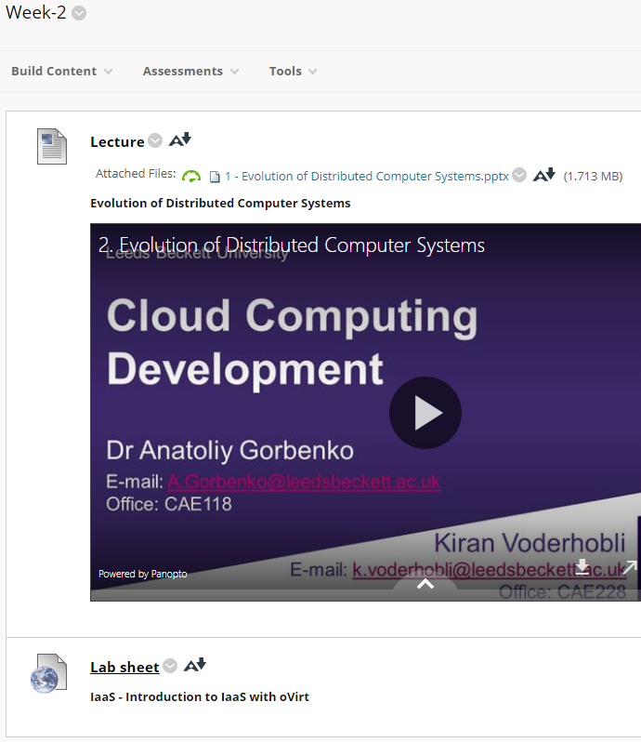
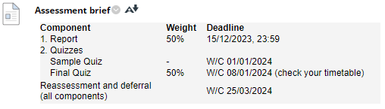
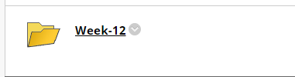
Learning environment - VLE
…

Slide 11
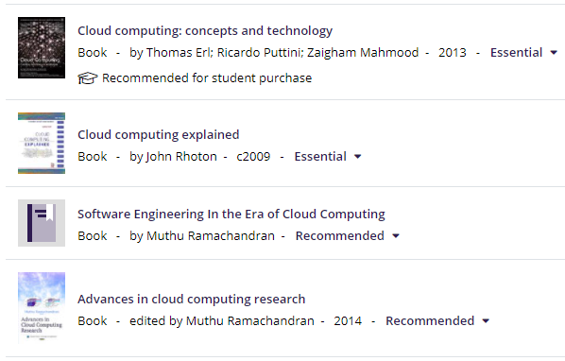
Reading List
Available via the Library

Slide 12
Timetable / Learning Activities
On-line pre-recorded lectures. Every week there will be some learning materials for you to engage in. Pre-recorded videos will also be released weekly, covering really important concepts
Check Teaching and Learning Materials folder
Look through lecture slides and watch lecture recordings as they are released.
On-site tutorials. Every week you will attend an on-site face-to-face tutorials. These sessions are to support you to work through your weekly lab activities.
Check your timetable when to attend.
Check Teaching and Learning Materials folder for labsheets released weekly.

Slide 13
Assessment
Assessment Method: | Weighting: | Assessment date: | Feedback Method: | Feedback date:
1. Practical Experience Report (word count: 3000-4000) | 50% Learning Outcomes Assessed: 2, 4 | 15/12/23 (23:59) | Via MYBECKETT | Within 4 weeks
2. Supervised closed book test (MCQ) | 50% Learning Outcomes Assessed: 1, 3 | TBC W/C 08/01/2024 | Via MYBECKETT | Immediately
Reassessment and deferral (all components) |  | TBC W/C 25/03/2024 | Via MYBECKETT

Slide 14
Practical Experience Report (1)
You will plan, carry out an audit and report you practical experience on choosing and using IaaS or PaaS cloud system to deploy your own SaaS application.
The major purpose of the report is to demonstrate your practical skills on using cloud services, developing and deploying cloud-based applications.
Practical experience report should present: (i) the background to the decisions made – introduction to Cloud Computing technologies (properties, models, types, providers), (ii) describes the chosen IaaS/PaaS cloud service and provider, (iii) reports the process of virtual machine/environment deployment, configuration and use (iv) describes a process of cloud web service and a client development and deployment, and (v) demonstrates the usage of your testbed cloud application.
Submission Dates: 15/12/2023 (23:59)

Slide 15
Practical Experience Report (2)
In order to successfully achieve this outcome, you will be required to:
Select a Cloud provider which cloud service you are going to use;
Select IaaS or PaaS cloud service to work with;
Research in depth architectural and other features of the chosen cloud service;
Get access to the chosen cloud service, deploy and configure your virtual machine/environment (most of the cloud providers offer a free trial access to their IaaS/PaaS services);
Develop, deploy and run your own testbed web service on your IaaS/PaaS service (you can use any programming language; there is no need to develop something really complicated; for instance, it can be a web-service which converts different units between UK and metric system; though, your own ideas are appreciated and originality of your product will be accounted during assessment);
Develop a testbed client application to communicate with your cloud web service (it can be a command-line, window or web-based applications).
Produce a practical experience report

Slide 16
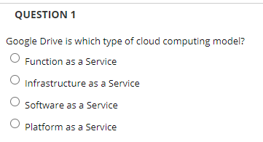
Final exam
Closed-book supervised MTQ quiz: 50 questions / 40 minutes
Covers lecture materials and lab tasks
A sample quiz will be released a week before the final exam
Submission Dates: W/C 08/01/2024

Slide 17
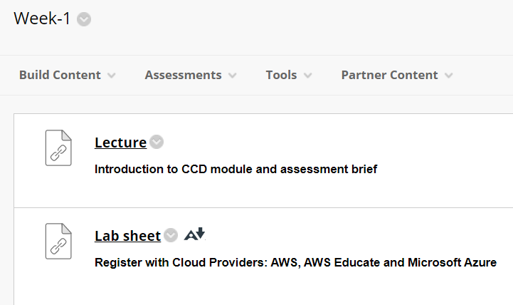
Getting started
Read and complete:

Slide 18
Questions?

